Slide 1



A Summary of 1076 - 2019 IEEE Standard VHDL Language Reference Manual
by Furkan Kaya, Koray Karakurt,
Mert Ecevit, Orhan Çalışkan, Seyit Koçak and Yunus Küçük
27/12/2024

Slide 2
3. Design entities & configurations
Chapter 3
Presenter:
Furkan Kaya
3.1 General
3.2 Entity Declarations
3.3 Architecture Bodies
3.4 Configuration Declarations

Slide 3
3.1 GENERAL
Design
3.2 ENTITY DECLARATIONS
Architecture

Slide 4
CODE EXAMPLE
library IEEE;
use IEEE.std_logic_1164.all;
use IEEE.numeric_std.all;
entity generic_adder is
generic
(
data_width : integer := 32
);
port
(
input_a : in std_logic_vector (data_width-1 downto 0);
input_b : in std_logic_vector (data_width-1 downto 0);
output_adder : out std_logic_vector (data_width downto 0)
);
end generic_adder;
architecture behavioral of generic_adder is
signal output_internal : signed (output_adder'range);
begin
output_internal <= signed(input_a) + signed(input_b);
output_adder <= std_logic_vector(output_internal);
end architecture behavioral;

Slide 5
4. Subprograms & packages
Chapter 4
Presenter:
Seyit Koçak
4.1 General
4.2 Subprogram Declarations
4.3 Subprogram Bodies
4.4 Subprogram Instantiation Declarations
4.5 Subprogram Overloading
4.6 Resolution Functions
4.7 Package Declarations
4.8 Package Bodies
4.9 Package Instantiation Declarations
4.10 Conformance Rules

Slide 6
4.1 GENERAL
Subprograms define algorithms through procedures and functions, serving to compute values or perform actions
Procedures are subprograms that execute a series of statements to perform actions but do not return a value. They are called as statements and can modify the state of the program
Functions are classified as pure or impure
Packages separate the declarations and bodies of these subprograms, allowing common resources to be shared
4.2 SUBPROGRAM DECLERATİONS
Subprogram declarations define procedures or functions by specifying their designator, parameters, generics (if any), and for functions, the return type and whether it is pure or impure
Procedures are always identified by a name, while functions can also be identified by operator symbols, enabling operator overloading
Functions return a value, whereas procedures execute actions without returning any value and can modify external variables or signals
-

Slide 7
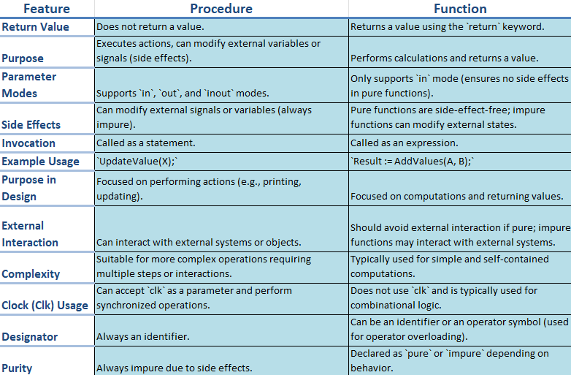
CODE EXAMPLE
library IEEE;
use IEEE.std_logic_1164.all;
use IEEE.numeric_std.all;
entity procedurewithclock is
port (
clk : in std_logic;
reset : in std_logic;
data_in : in std_logic_vector(7 downto 0);
data_out : out std_logic_vector(7 downto 0)
);
end procedurewithclock;
architecture behavioral of procedurewithclock is
procedure updatevalue(
signal clk : in std_logic;
signal reset : in std_logic;
signal data_in : in std_logic_vector(7 downto 0);
variable data_out : inout std_logic_vector(7 downto 0)
) is
begin
if reset = '1' then
data_out := (others => '0');
elsif rising_edge(clk) then
data_out := data_in;
end if;
end procedure;
begin
process(clk, reset)
variable temp_data : std_logic_vector(7 downto 0);
begin
updatevalue(clk, reset, data_in, temp_data);
data_out <= temp_data;
end process;
end behavioral;

Slide 8
4.2 SUBPROGRAM DECLARATİONS
Pure functions always return the same output for the same input values
Impure functions may produce different outputs for the same inputs or modify external variables or signals
Constant parameters allow read-only access, while variable parameters allow both reading and writing of values during subprogram execution.
Signal parameters pass references to signals, their drivers, or both into the subprogram call Assignments to signal parameters directly affect the actual signal drivers associated with them
4.3 SUBPROGRAM BODIES
A body consists of three main parts: specification (definition of parameters and type), declarative part (variables, constants, or nested subprograms), and statement part (sequential operations)
4.4 SUBPROGRAM INSTANTIATION DECLARATIONS
Subprogram instantiation customizes a general subprogram template into an independent version with specific parameters or generics

Slide 9
CODE EXAMPLE
library IEEE;
use IEEE.std_logic_1164.all;
use IEEE.numeric_std.all;
package my_subprograms is
function add_integer(a, b: integer) return integer;
end my_subprograms;
package body my_subprograms is
function add_integer(a, b: integer) return integer is
begin
return a + b;
end add_integer;
end my_subprograms;
use work.my_subprograms.all;
entity subprograminstantiationexample is
port (
a, b : in integer;
c, d : in integer;
result_int : out integer;
result_real: out integer
);
end subprograminstantiationexample;
architecture behavioral of subprograminstantiationexample is
constant threshold : integer := 10;
begin
process(a, b, c, d)
variable tempresultint : integer; --temporary storage
variable tempresultreal : integer;
begin
if (a > threshold and b > threshold) then
tempresultint := add_integer(a, b);
result_int <= tempresultint;
else
result_int <= 0;
end if;
if (c > threshold and d > threshold) then
tempresultreal := add_integer(c, d);
result_real <= tempresultreal;
else
result_real <= 0;
end if;
end process;
end behavioral;

Slide 10
4.7,8,9 PACKAGE DECLARATIONS,BODIES,INSTANTIATION
Package declarations define the interface of a package, including constants, types, subprograms, and generics
Items declared in a package can be made visible in other design units through selection or use clauses
A package body must match its corresponding package declaration and follow it in the same declarative region
Package instantiation declarations create an instance of an uninstantiated package, associating actuals with generics through a generic map aspect
The instance behaves like a generic-mapped package with declarations and bodies from the uninstantiated package
CODE EXAMPLE
library IEEE;
use IEEE.std_logic_1164.all;
package mypackage is
constant default_value: integer := 10;
function double(value: integer) return integer;
function triple(value: integer) return integer;
end package mypackage;
package body mypackage is
function double(value: integer) return integer is
begin
return value * 2;
end function double;
function triple(value: integer) return integer is
begin
return value * 3;
end function triple;
end package body mypackage;
entity packageexample is
port (
inputvalue : in integer;
outputvalue : out integer;
triplevalue : out integer
);
end packageexample;
architecture behavioral of packageexample is
use work.mypackage.all;
begin
process(inputvalue)
begin
outputvalue <= double(inputvalue);
triplevalue <= triple(inputvalue);
end process;
end behavioral;

Slide 11
5. tYPES
Chapter 5
Presenter:
Seyit Koçak
5.1 General
5.2 Scalar Types
5.3 Composite Types
5.4 Access Types
5.5 File Types
5.6 Protected Types
5.7 String Representations
5.8 Unspecified Types

Slide 12
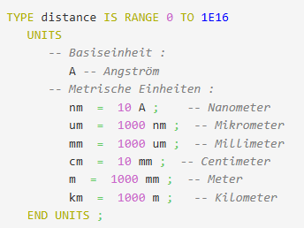
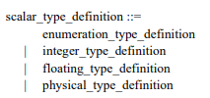
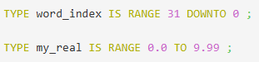
5.1 GENERAL
A type is defined by a set of values and operations, including basic and predefined operations automatically provided
Composite types can be unconstrained, fully constrained, or partially constrained
Types are divided into five main categories: scalar, composite, access, file, and protected types
5.2 SCALAR TYPES

Slide 13
CODE EXAMPLE
library ieee;
use ieee.std_logic_1164.all;
use ieee.numeric_std.all;
entity bcdtoseven is
port (
sw : in std_logic_vector(13 downto 0);
clk : in std_logic;
seg : out std_logic_vector(6 downto 0);
an : out std_logic_vector(3 downto 0)
);
end bcdtoseven;
architecture behavioral of bcdtoseven is
type digit_type is (ones_digit, tens_digit, hundreds_digit, thousands_digit);
signal current_digit : digit_type := ones_digit;
signal ones, tens, hundreds, thousands : std_logic_vector(3 downto 0);
signal slow_clk : std_logic := '0';
signal clk_divider : integer := 0;
function binary_to_seven_segment(input : std_logic_vector(3 downto 0)) return std_logic_vector is
variable seg_output : std_logic_vector(6 downto 0);
begin
case input is
when "0000" => seg_output := "1000000";
when "0001" => seg_output := "1111001";
when "0010" => seg_output := "0100100";
when "0011" => seg_output := "0110000";
when "0100" => seg_output := "0011001";
when "0101" => seg_output := "0010010";
when "0110" => seg_output := "0000010";
when "0111" => seg_output := "1111000";
when "1000" => seg_output := "0000000";
when "1001" => seg_output := "0010000";
when others => seg_output := "1111111";
end case;
return seg_output;
end function;
begin
process(clk)
begin
if rising_edge(clk) then
if clk_divider = 50000 then
slow_clk <= not slow_clk;
clk_divider <= 0;
else
clk_divider <= clk_divider + 1;
end if;
end if;
end process;
process(sw)
variable value_int : integer;
begin
value_int := to_integer(unsigned(sw));
thousands <= std_logic_vector(to_unsigned(value_int / 1000, 4));
hundreds <= std_logic_vector(to_unsigned((value_int / 100) mod 10, 4));
tens <= std_logic_vector(to_unsigned((value_int / 10) mod 10, 4));
ones <= std_logic_vector(to_unsigned(value_int mod 10, 4));
end process;
process(current_digit, ones, tens, hundreds, thousands)
begin
case current_digit is
when ones_digit => an <= "1110"; seg <= binary_to_seven_segment(ones);
when tens_digit => an <= "1101"; seg <= binary_to_seven_segment(tens);
when hundreds_digit => an <= "1011"; seg <= binary_to_seven_segment(hundreds);
when thousands_digit => an <= "0111"; seg <= binary_to_seven_segment(thousands);
when others => an <= "1111"; seg <= (others => '1');
end case;
end process;
process(slow_clk)
begin
if rising_edge(slow_clk) then
case current_digit is
when ones_digit => current_digit <= tens_digit;
when tens_digit => current_digit <= hundreds_digit;
when hundreds_digit => current_digit <= thousands_digit;
when thousands_digit => current_digit <= ones_digit;
when others => current_digit <= ones_digit;
end case;
end if;
end process;
end behavioral;

Slide 14
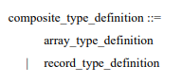
5.3 COMPOSITE TYPES
VHDL arrays store multiple elements of the same type in an organized way and provide fast access
Arrays are used for grouping data, modeling multidimensional structures, and performing operations on large data sets
They serve as a foundation for creating dynamic data structures and algorithms, enabling efficient data management and simulation
Record types in VHDL allow grouping of different types of elements under a single name, where each element can have a different data type
Record types are useful for modeling complex data structures where multiple related values need to be stored together, such as a set of properties for an object

Slide 15
5.4 ACCSESS TYPES
Access type provides a way to point to objects
Access type allows dynamically creating objects in memory
The DEALLOCATE procedure releases allocated memory
type Int_Ptr is access Integer;
variable Ptr : Int_Ptr := null; -- Initially points to nothing
-------------------------------------------------------------------------
Ptr := new Integer(5); -- Creates an integer object in memory with a value of 5
-------------------------------------------------------------------------
DEALLOCATE(Ptr); -- Frees the memory and sets Ptr to null
5.5 FILE TYPES
In VHDL, file types are used to define objects that represent files in the system, and the data within the file is constrained by a specific subtype
A file can be managed with operations like READ, WRITE, SEEK, and FLUSH, where the reading and writing modes determine the type of operation

Slide 16
5.6 PROTECTED TYPES
When to Use Protected Types?
When concurrent data access occurs (multiple processes need to access the same data simultaneously)
When the secure management of shared resources is required
When control and organization are necessary for data manipulation
When restricted access to critical sections is needed to ensure consistency and avoid race conditions
CODE EXAMPLE
library IEEE;
use IEEE.std_logic_1164.all;
use IEEE.numeric_std.all;
use work.sharedcounter.all;
entity protectedtypes is
port (
clk : in std_logic;
out_counter : out integer
);
end protectedtypes;
architecture behavior of protectedtypes is
shared variable counter: sharedcounter;
begin
process(clk)
begin
if rising_edge(clk) then
counter.increment;
end if;
end process;
process(clk)
begin
if rising_edge(clk) then
out_counter <= counter.getvalue;
end if;
end process;
end behavior;
library IEEE;
use IEEE.std_logic_1164.all;
use IEEE.numeric_std.all;
protected type sharedcounter is
procedure increment;
function getvalue return integer;
end protected;
protected body sharedcounter is
variable count: integer := 0;
procedure increment is
begin
count := count + 1;
end procedure;
function getvalue return integer is
begin
return count;
end function;
end protected body;

Slide 17
5.7 STRING REPRESENTATIONS
Why is String Representations under the types section?
Strings are a VHDL type: Defined as arrays of characters, part of the type hierarchy
Ensures type safety: Fixed or constrained strings prevent design errors
Essential for testing: Key for assertions, debugging, and messages
5.8 UNSPECIFIED TYPES
Unspecified types allow abstract type definitions in VHDL
They are used for generics, ports, and parameters
Types are determined during elaboration
They support scalar, array, access, and file types
These types enable flexible and reusable designs

Slide 18
14. ELABORATION AND EXECUTION
Chapter 14
Presenter:
Seyit Koçak
14.1 General
14.2 Elaboration of a Design Hierarchy
14.3 Elaboration of a Block, Package, Subprogram or Protected Type Header
14.4 Elaboration of a Declarative Part
14.5 Elaboration of a Statement Part
14.6 Dynamic Elaboration
14.7 Execution of a Model

Slide 19
14.1 GENERAL
To execute a model, the design hierarchy is first elaborated, followed by the initialization of nets, and then the repetitive simulation cycle begins, during which processes are executed and nets are updated
14.2 ELABORATION OF A DESIGN HIERARCHY
Definition: Creates processes interconnected by nets, enabling simulation
Process:
Executes vhpiCbStartOfElaboration and vhpiCbEndOfElaboration callbacks.Prepares block statements and implicit configurations for unbound components
Key Steps:
Elaborates packages sequentially to resolve dependencies
Configures PSL verification units after block elaboration
Creates drivers and initializes scalar signals

Slide 20
14.3 ELABORATION OF a BLOCK, PACKAGE, SUBPROGRAMS OR PROTECTED TYPE HEADER
Describes the preparation of protected types, generics, subprograms, and ports, including their mapping and association. This ensures all components are properly initialized and ready for simulation
14.4 ELABORATION OF A DECLARATIVE PART
Type definitions, subtypes, subprograms, and protected types are elaborated sequentially
. Attribute, configuration, and disconnection specifications are processed
Binding information, default values, and signal associations are properly established
14.5 ELABORATION OF A STATEMENT PART
Purpose:
Ensure concurrent statements are correctly prepared for simulation
Concurrent Statements:
All concurrent statements in a block are elaborated sequentially
Generate Statements:
For-Generate: Creates blocks for each value in a specified range
If-Generate: Creates a block if the condition evaluates to true; otherwise, no block is created
Case-Generate: Creates a block for the matching alternative based on an evaluated expression
Component Instantiation: If bound to a design entity, the corresponding block is elaborated

Slide 21
14.6 DYNAMIC ELABORATION
Definition:
Dynamic elaboration occurs during simulation execution for constructs with sequential statements
Key Instances:
Loop Statements: Loop parameters are elaborated, and the range is evaluated before execution
Subprogram Calls: Parameters are elaborated and checked; exclusive access is required for protected or file operations
Allocators: Subtype elaboration occurs before object allocation
Sequential Blocks: Declarative parts are elaborated before block execution
14.7 EXECUTION OF A MODEL
Drivers: Handle signal value changes via transactions
Signal Updates: Compute and apply driving and effective values
Implicit Signals: Update signals like S'STABLE and S'QUIET per kernel rules

Slide 22
CODE EXAMPLE
library IEEE;
use IEEE.std_logic_1164.all;
use IEEE.numeric_std.all;
entity generic_adder is
generic
(
data_width : integer := 32
);
port
(
input_a : in std_logic_vector (data_width-1 downto 0);
input_b : in std_logic_vector (data_width-1 downto 0);
output_adder : out std_logic_vector (data_width downto 0)
);
end generic_adder;
architecture behavioral of generic_adder is
signal output_internal : signed (output_adder'range);
begin
output_internal <= signed(input_a) + signed(input_b);
output_adder <= std_logic_vector(output_internal);
end architecture behavioral;

Slide 23
End of IEEE 1076 – 2002 Standard
VHDL Project Closure Presentation
THANKS
Furkan Kaya,
Mert Ecevit,
Orhan Çalışkan,
Seyit Koçak
Yunus Küçük
www.youtube.com/@falsepaths

